Slide 1
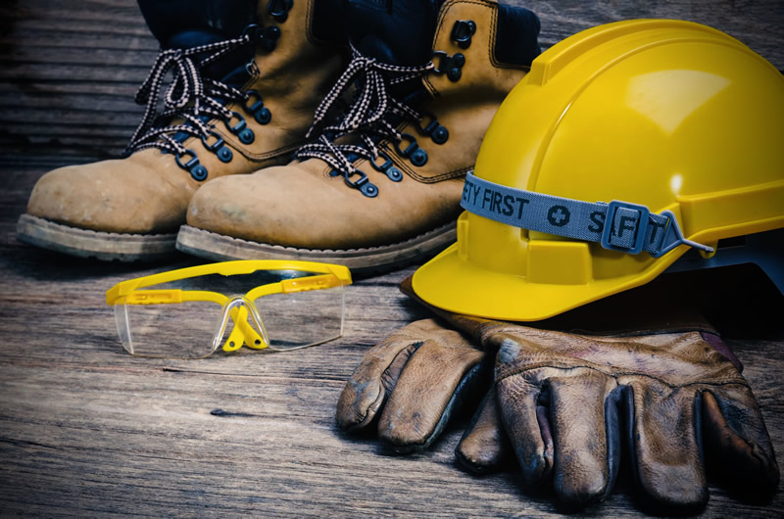
P . Geetha Mounika
Roll No: 121322030021
Enhancing Safety Item Recognition For Personal Protective Equipment (PPE)

Slide 2
ABSTRACT
This Project Focuses On The Development Of A PPE Detection System Using The You Only Look Once (YOLO) Algorithm With Machine Learning Technologies. The Primary Objective Is To Leverage Yolo's Real-time Object Detection Capabilities To Identify And Classify Personal Protective Equipment (PPE) In Various Environments
The Project Aims To Contribute To Workplace Safety By Automating The Recognition Of Key PPE Components, Such As Helmets, Safety Goggles, Vests, Gloves, And Boots. The Simplicity And Efficiency Of YOLO Make It A Suitable Candidate For This Task, Promising A Straightforward Yet Effective Solution For Enhancing Safety Protocols Through Automated PPE Detection

Slide 3
INTRODUCTION
There Have Been Many Accidents In Construction Sites Due To Lack Of Safety Measures.
A Major Reason For This Has Been Workers Not Wearing Personal Protective Equipment (PPE) For Their Safety. Detecting PPEs Become Very Crucial For The Continuous Monitoring Of Worker Safety
The Proper Use Of Personal Protective Equipment (PPE) Is Fundamental. This Project Delves Into The Application Of Machine Learning, Specifically The YOLO Model, To Streamline PPE Detection. By Harnessing Yolo's Efficiency In Real-time Object Recognition, The Goal Is To Create A System That Automates The Identification Of PPE In Industrial Settings. This Endeavor Aims To Enhance Safety Protocols By Providing A Technologically Advanced Solution For Monitoring And Ensuring The Consistent Adoption Of Essential Protective Gear

Slide 4
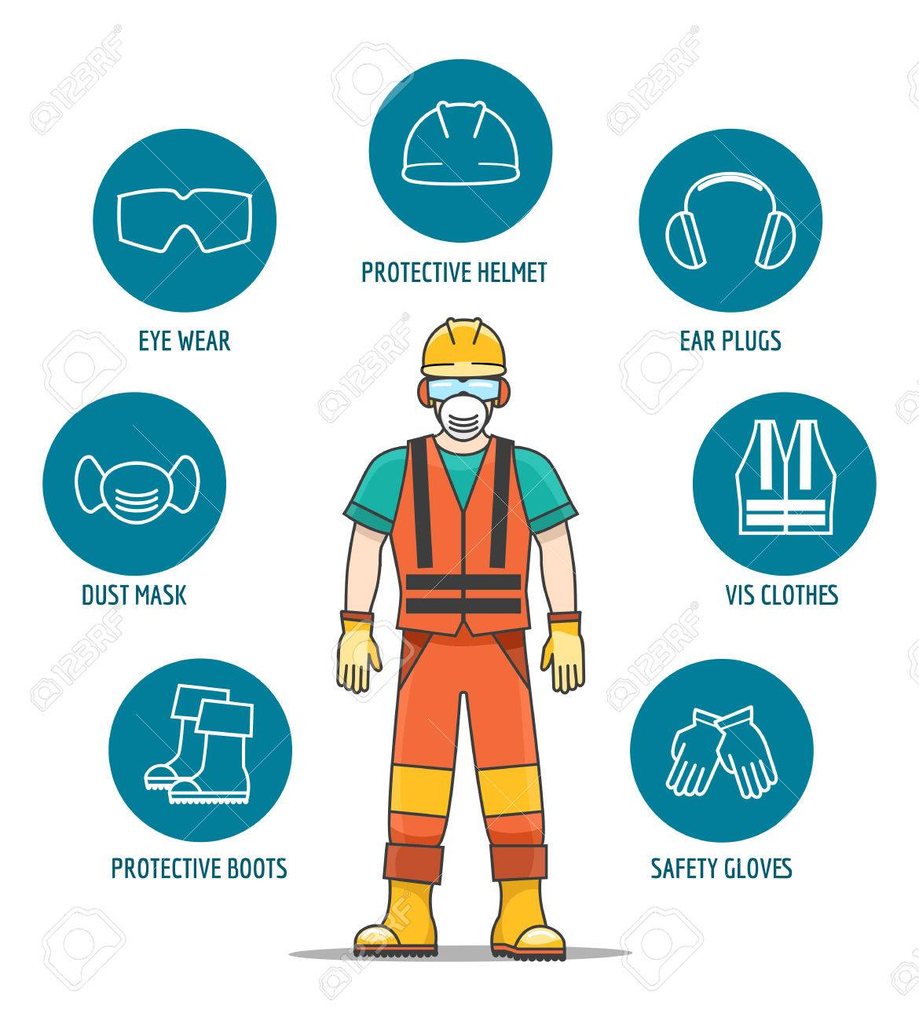
TYPES OF OBJECTS

Slide 5
WHAT IS PPE
[PPE] Stands For Personal Protective Equipment. Personal Protective Equipment Refers To Specialized Gear Or Clothing Worn By Individuals To Protect Themselves From Various Hazards In Their Environment. The Primary Purpose Of PPE Is To Minimize Exposure To Potential Risks And Prevent Injuries, Or Other Forms Of Harm. PPE Is Commonly Used In Workplaces

Slide 6
DATASET COLLECTION
A dataset for PPE (Personal Protective Equipment) detection typically consists of images The dataset would include multiple categories of PPE items like
(0 = Dust Mask),(1=Eye Wear),(2=Glove),(3= Protective Boots),(4=Protective Helmet),
(5= Safety Vest),(6= Shield)
The Dataset Name Is COCO It Contains 3290 total Images In This Dataset Contains (TRAIN ,TEST, VALID) In It Contains 2 Columns i.e Images And Labels
In Training SET Contains Of 2311 Images, VALID SET Contains 652 Images, TEST SET Contains 327 Images

Slide 7
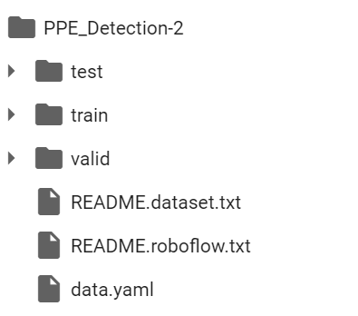
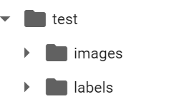
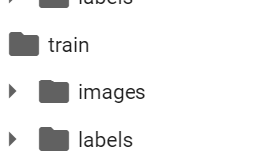


Slide 8
OBJECTIVE
To Implement Measures That Ensure The Safety And Well-being Of All Workers On Construction Sites, Preventing Accidents, Injuries, And Fatalities."
This Objective Encapsulates The Fundamental Goal Of Construction Safety, Which Is To Protect The Health And Safety Of Workers While They Are Engaged In Construction Activities. It Emphasizes The Importance Of Implementing Effective Safety Measures And Protocols To Minimize Risks And Create A Safe Working Environment. This Objective Can Serve As A Guiding Principle For Construction Companies, Project Managers, And Workers To Prioritize Safety And Make Informed Decisions That Prioritize The Well-being Of Everyone Involved In Construction Projects.

Slide 9
SCOPE AND APPLICABILITY
The Scope And Applicability Of PPE Detection For Construction Site Safety Are Extensive And Crucial For Ensuring The Well-being Of Workers And Minimizing Occupational Hazards. Here's A Breakdown Of The Scope And Applicability
Worker Protection
Compliance Monitoring
Site Safety Management
Emergency Response
Risk Mitigation
Overall, PPE Detection Systems Play A Vital Role In Enhancing Construction Site Safety By Ensuring Compliance With Safety Regulations, Protecting Workers From Occupational Hazards, Facilitating Emergency Response Efforts, And Mitigating Risks Associated With Construction Activities. Their Scope And Applicability Extend Across Various Aspects Of Construction Site Management, Making Them Indispensable Tools For Promoting A Culture Of Safety And Well-being In The Construction Industry.

Slide 10
REQUIREMENTS
To Implement PPE (Personal Protective Equipment) Detection Using Yolov5 (You Only Look Once Version 5) I Used Google Colab
Hardware Requirements:
GPU: Yolov5 Is Optimized For GPU Usage. Having A Powerful GPU Will Significantly Speed Up The Training And Inference Processes.
Memory: Sufficient GPU Memory For Training And Inference.
Main Libraries used for this project
Pytorch
Yolov5
Super-gradients
Ultralytics
Roboflow

Slide 11
PROBLEM DEFINITION
The Construction Site Safety Project Aims To Tackle Persistent Challenges In Worker Well-being By Addressing Key Issues Such As The Frequency Of Accidents, Inadequacies In Existing Safety Measures, Limited Awareness Among Workers, And Delayed Response Mechanisms. Focused On Enhancing The Construction Environment, The Project Will Review And Update Safety Protocols, Implement Targeted Training Programs, Introduce Real-time Monitoring Systems, And Foster Improved Communication Channels. With The Ultimate Goal Of Reducing Accidents And Injuries, Increasing Adherence To Safety Protocols, And Fostering A Proactive Safety Culture Among Construction Personnel, This Project Endeavors To Create A Safer And Healthier Working Environment. Success Will Be Measured By A Notable Decrease In Reported Accidents, Heightened Safety Compliance, In Construction Site Activities.

Slide 12
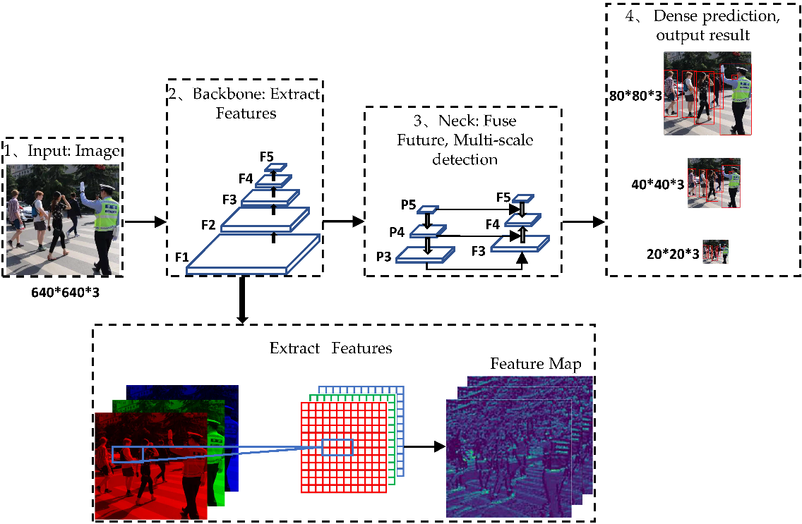
IMPLEMENTATION RESULTS
The Model-configurations File Dictates The Model Architecture. Ultralytics Supports Several Yolov5 Architectures, Named P5 Models, Which Varies Mainly By Their Parameters Size: Yolov5n (Nano), Yolov5s (Small), Yolov5m (Medium), Yolov5l (Large), Yolov5x (Extra Large). These Architecture Are Suitable For Training With Image Size Of 640*640 Pixels

Slide 13
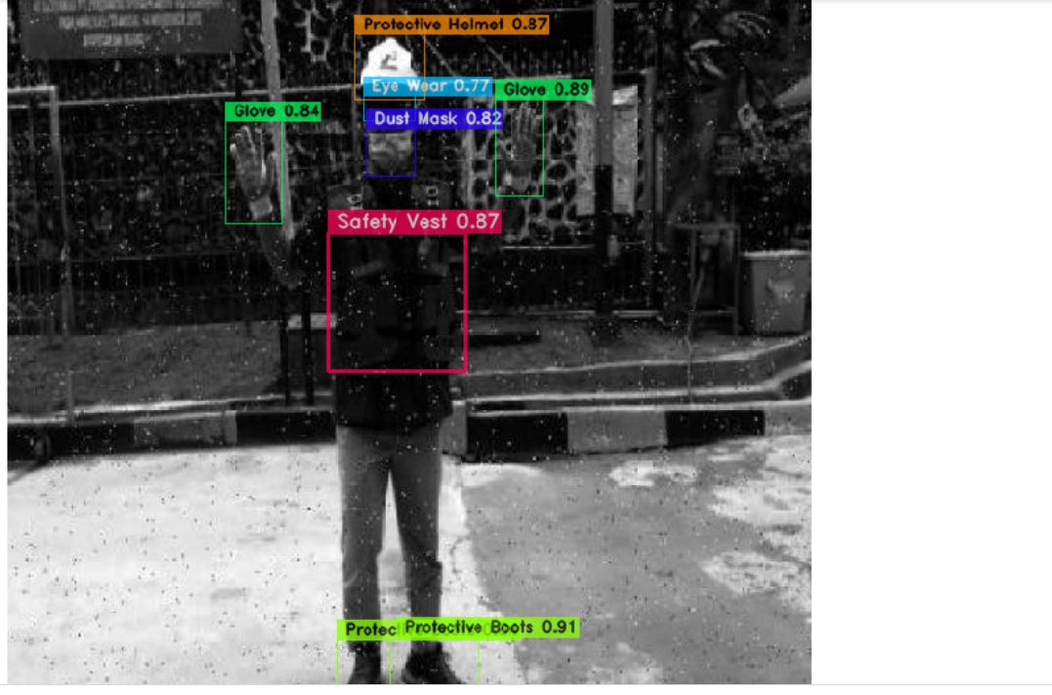
Trained Data Image

Slide 14
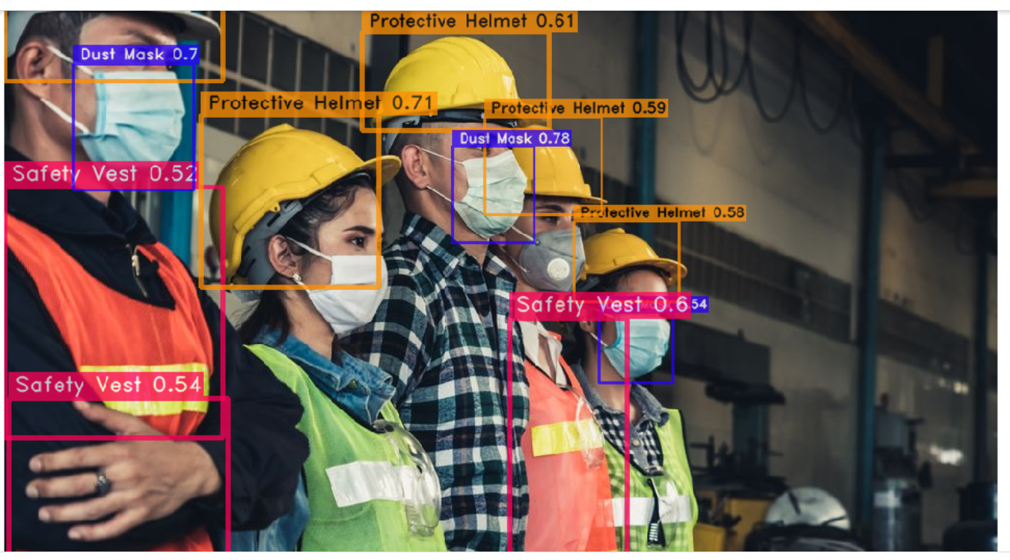
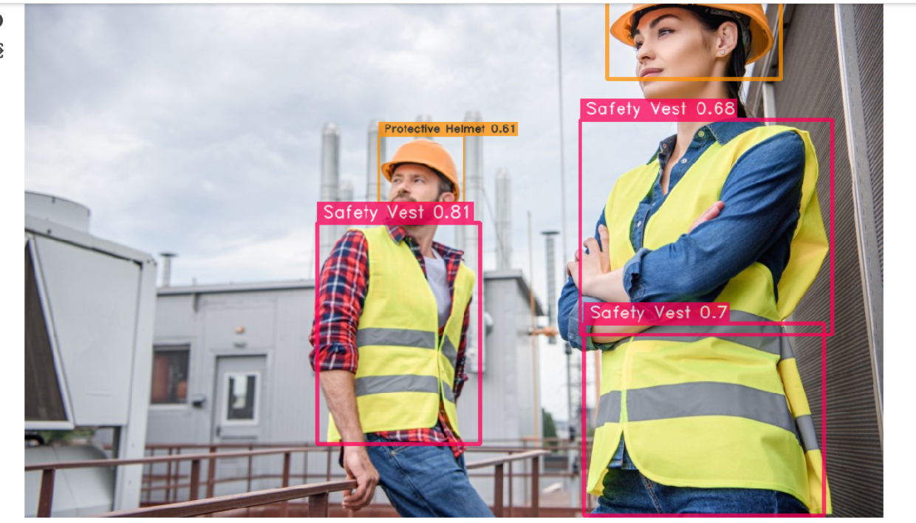
From Google Images

Slide 15
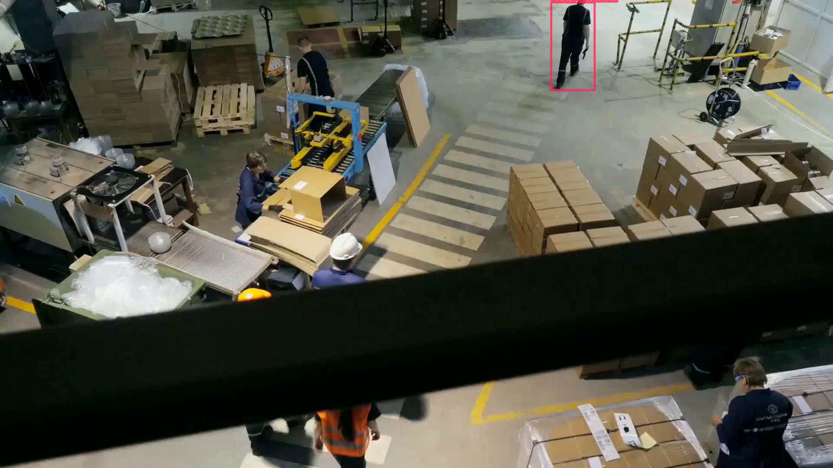
Vedio

Slide 16
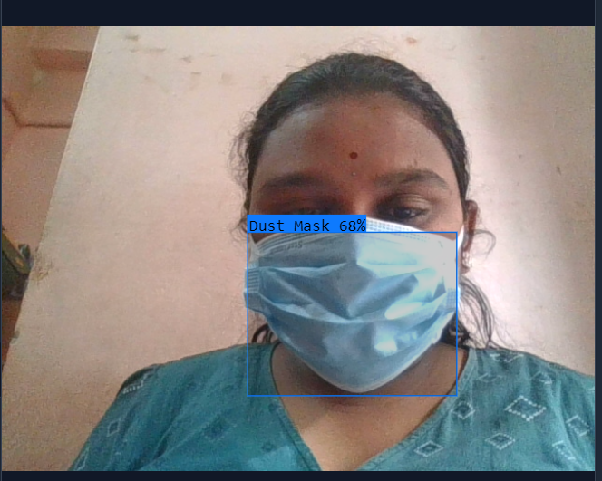
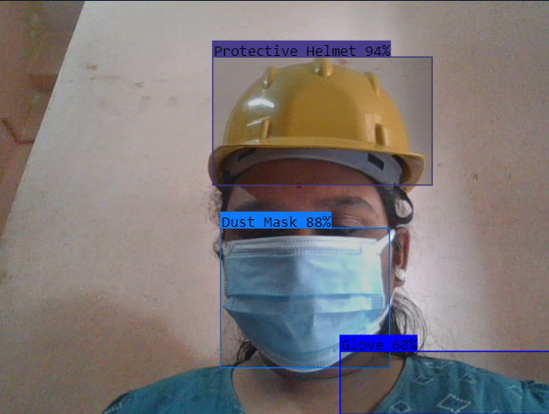
Interface screen shot

Slide 17
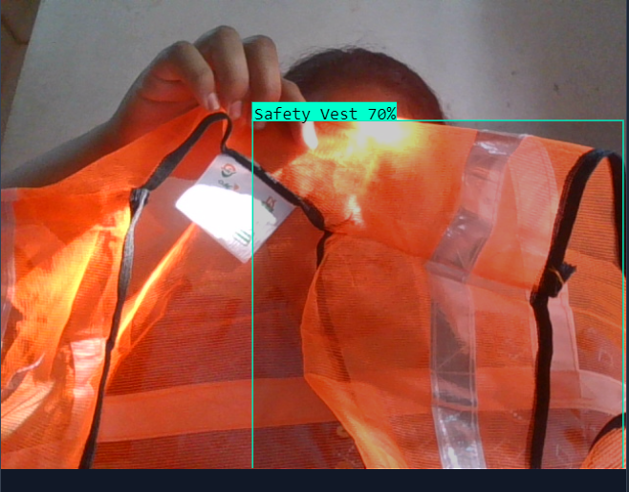
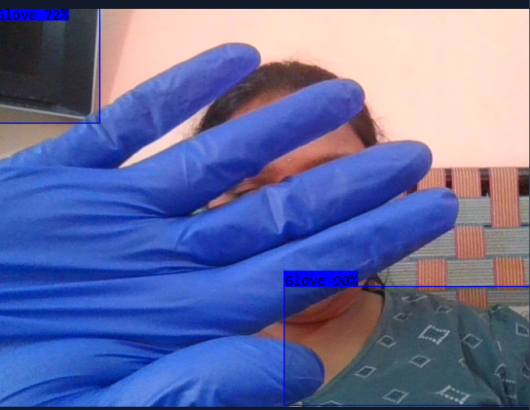

Slide 18
CODING DETAILS
Implementing Personal Protective Equipment (PPE) Detection Using Yolov5 Involves Several Steps, Including Setting Up The Yolov5 Environment
Install The Required Packages & Run The Code In Python Integrated Environment
Insert The Dataset Using Roboflow
Training The Yolov5 Model
Insert An Image And Check If It's Correctly Detecting
Download The Image From Google Or Dataset And Check The Detection

Slide 19
CONCLUSION
In Conclusion, The Implementation Of Personal Protective Equipment (PPE) Detection Using Yolov5 Presents A Robust And Effective Solution For Enhancing Workplace Safety. By Setting Up The Yolov5 Environment, Preparing A Well-annotated Dataset, Training The Model, And Performing Inference, The System Demonstrates The Potential To Significantly Reduce Workplace Accidents And Injuries. The Trained Model, With Its Ability To Identify And Localize Various PPE Items, Offers A Valuable Tool For Ensuring Compliance With Safety Protocols. The Utilization Of Real-time Monitoring And Detection Contributes To A Proactive Safety Culture, Empowering Organizations To Create Safer Working Environments For Their Personnel. Continuous Refinement And Adaptation Of The Model Based On Evolving Safety Requirements. Overall, The PPE Detection System Using Yolov5 Stands As A Promising And Impactful Technological Solution In Fostering A Secure And Health-conscious Work Environment.

Slide 20
THANK YOU

